Slide 1

Chain of Responsibility
Brad Motley
Dr. Bowring - CSCI360
Software Architecture & Design

Slide 2
CoR – Intent
The Chain of Responsibility (CoR) is a design pattern which uses a chain of objects (LinkedList) to handle an event or processing request.

Slide 3
Motivation
Consider a Car Dealership Service Department.
  A client has a problem with his/her car and needs it repaired.
  A request is sent by the client to the employee at the desk.
  The desk worker does not handle the request so it is forwarded to a mechanic & down the chain until it is handled.
  When the request is handled and the customer picks up the car from the desk employee, (s)he does not aware of the actual mechanic that handled it, only the desk employee.

Slide 4
Motivation
Client
Desk Employee
Mechanic Employee

Slide 5
Applicability
The Chain of Responsibility can be used when:
  You want to decouple a request’s sender & receiver.
  You don’t want to specify handlers in your code.
  Multiple objects may be handling requests (you may not be sure of exactly which one).

Slide 6
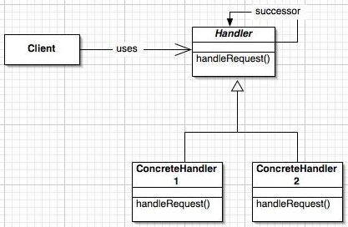
Structure

Slide 7
Participants
Client: The party responsible for sending the request(s).
Request: Something that requires processing of some kind, typically an event.
Abstract Handler: The shell or interface of which a concrete handler is an extension.
Concrete Handler: The object responsible for handling the event or request.

Slide 8

Collaboration
Objects (Concrete Handlers) in the chain pass the request forward until one of the objects handles it.
Processing stops after the request is handled.

Slide 9
Consequences
  Reduces coupling between the senders of requests & request handlers.
    Multiple objects have a chance at request handling.
    Senders and Receivers have no knowledge of one another.
  Requests can go unhandled by falling off the end of the chain (list) without being received by a handler.
  The chain of handlers can be modified easily by changing pointers in the list.

Slide 10
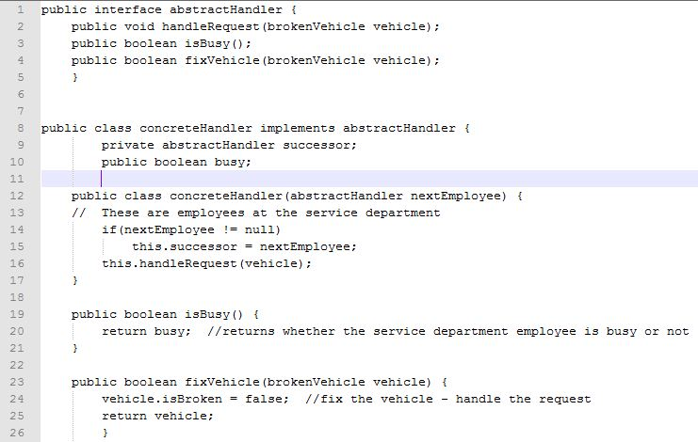
Example

Slide 11
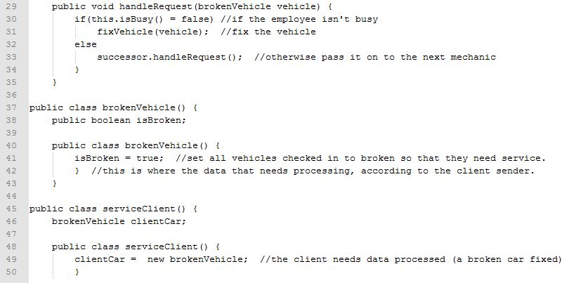
Example - Continued

Slide 12
Related Strategies
One of the most common pattern usages is to use a series of Strategy classes to handle different types of requests.
Factory patterns can also be used similarly to obtain proper handlers.

